Slide 1
Image Classification
Liu, Zhenyan

Slide 2
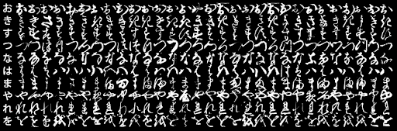
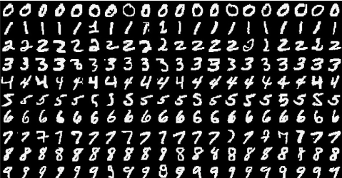
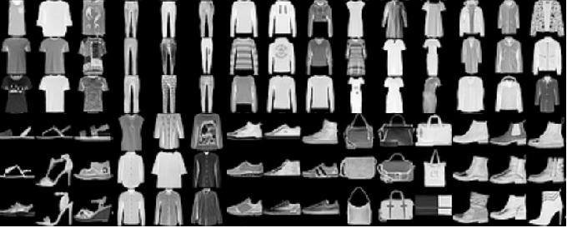
Datasets
KMNIST
MNIST
FashionMNIST

Slide 3

Models
Linear Function
$$y=log_softmax(W^{T}x+b)$$
Fully Connected Layers
$$y^{0}=\tanh\left(fc1\left(x\right)\right)$$
$$y= log_softmax(fc2\left(y^{0}\right))$$
Convolutional Neural Networks
$$y^{0}=conv2\left(conv1\left(x\right)\right)$$
$$y= log_softmax(fc\left(y^{0}\right))$$

Slide 4

此处进行demo

Slide 5
Ablation
For Linear function, try to change batch_size to 16
Test set: Average loss: 1.0733, Accuracy: 6909/10000 (69%)
For Fully connected layers, there is a hyperparameter named hidden_size, which is the number of nodes between the first layer and the second layer
Hidden_size = 50: Test set: Average loss: 0.5354, Accuracy: 8369/10000 (84%)
Hidden_size = 100: Test set: Average loss: 0.5340, Accuracy: 8341/10000 (83%)
Hidden_size = 300: Test set: Average loss: 0.4903, Accuracy: 8453/10000 (85%)
Hidden_size = 500: Test set: Average loss: 0.4905, Accuracy: 8379/10000 (85%)
For Convolutional neural network, I remove the second convolutional layer
Test set: Average loss: 0.3696, Accuracy: 8981/10000 (90%)

Slide 6
Results
MNIST
Lin: Test set: Average loss: 0.2921, Accuracy: 9115/10000 (91%)
Full: Test set: Average loss: 0.1464, Accuracy: 9559/10000 (96%)
Conv: Test set: Average loss: 0.0296, Accuracy: 9887/10000 (99%)
KMNIST
Lin: Test set: Average loss: 1.0220, Accuracy: 6918/10000 (69%)
Full: Test set: Average loss: 0.4912, Accuracy: 8453/10000 (85%)
Conv: Test set: Average loss: 0.2403, Accuracy: 9312/10000 (93%)
FashionMNIST
Lin: Test set: Average loss: 0.4624, Accuracy: 8365/10000 (84%)
Full: Test set: Average loss: 0.3767, Accuracy: 8646/10000 (86%)
Conv: Test set: Average loss: 0.2699, Accuracy: 9019/10000 (90%)

